Slide 1
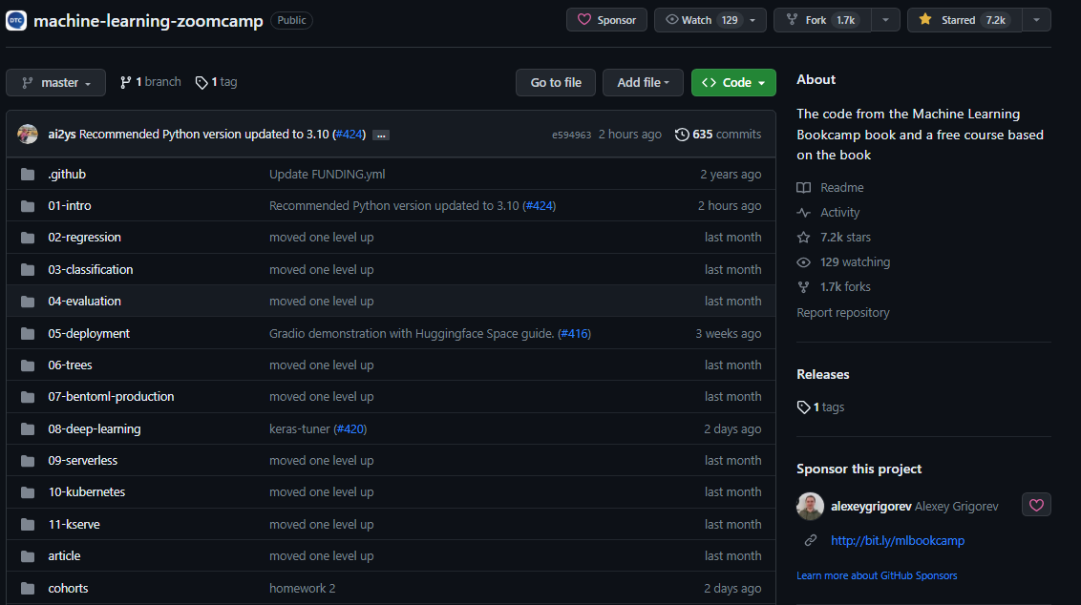
Machine Learning Zoomcamp
Data Talks Club: Link

Slide 2
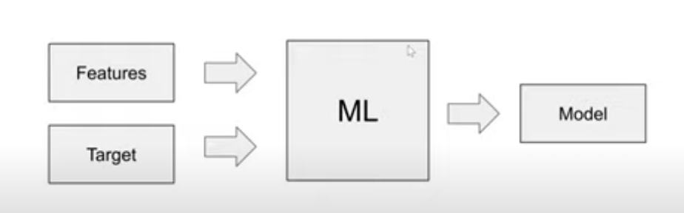
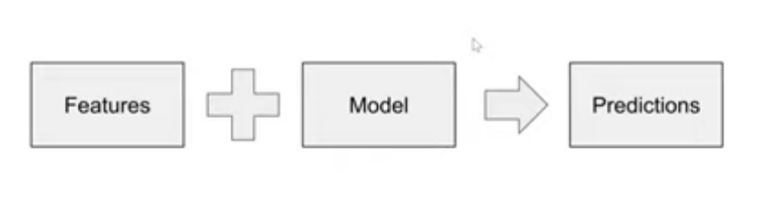
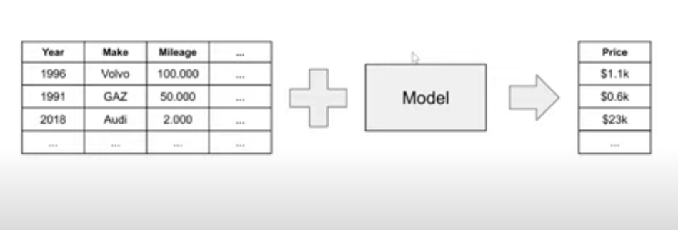
ML is the process of extracting patterns from data
Data is of 2 types Features and Target(Prediction from Model)

Slide 3
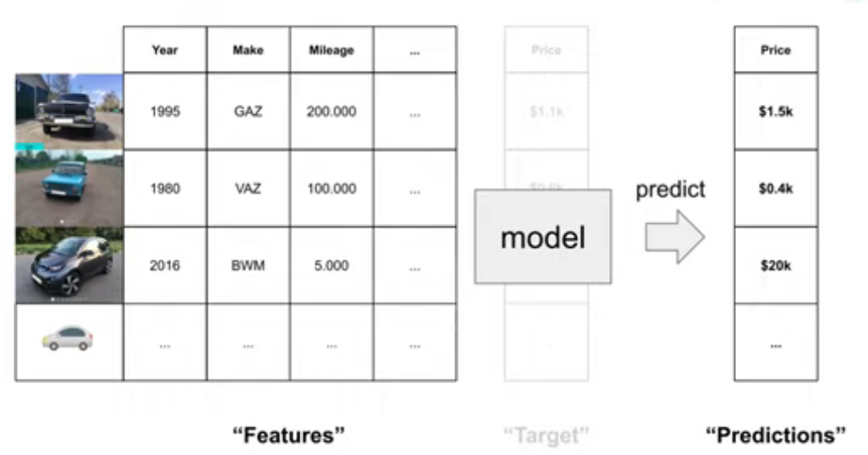
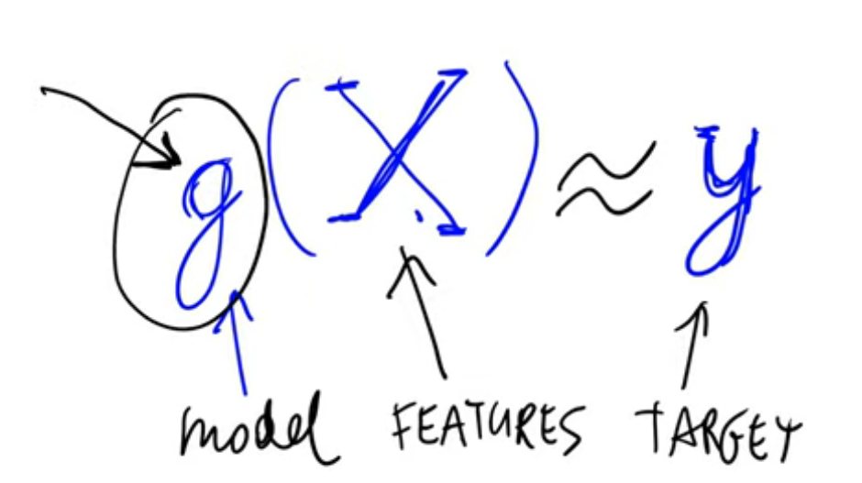
Supervised learning
The goal of SL is to come up with a model g which takes a feature matrix ‘x’ as input and learn to predict the output as close to the target example ‘y’
1. Predict a numerical value: Regression
Predicts a continuous number
Eg: Price , Area, Height etc.
2. Predict a category: Classification
Predicts a category
Binary classification only gives one of 2 output categories
Multicategory Classification has more than 2 options as classification output
Eg: Spam or not, True false,
3. Ranking: Recommender Systems
Rank the result based on the score assigned
Eg: E commerce, Google search

Slide 4
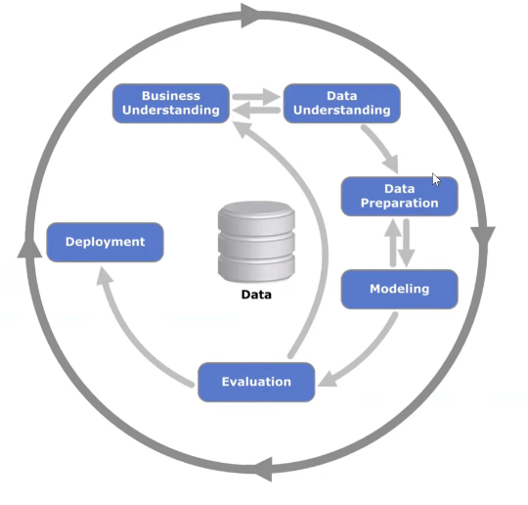
CRISP-DM
Cross Industry Standard Process for Data Mining by IBM
1. Business Understanding
Understand the extent of problem and decide suitability of ML based system
Define Goal
Goal has to be measurable (Eg: reduce the spam detection by 80%)
2. Data Understanding
Identify data collection and replication method
Need to add more data or not by going back to the previous step
3. Data Preparation
Clean data to be ready to apply ML models
Tabular formatting of data with features and target variable labelling
4. Modelling
Machine Learning Step
If new features or problems with data detected, go back to the previous step and reformat data.
5. Evaluation
Compare result with goals
Decide whether it is acceptable
5. Deployment
Deploy to users
Test maintainability through monitoring
Go back to business goals for further improvement

Slide 5
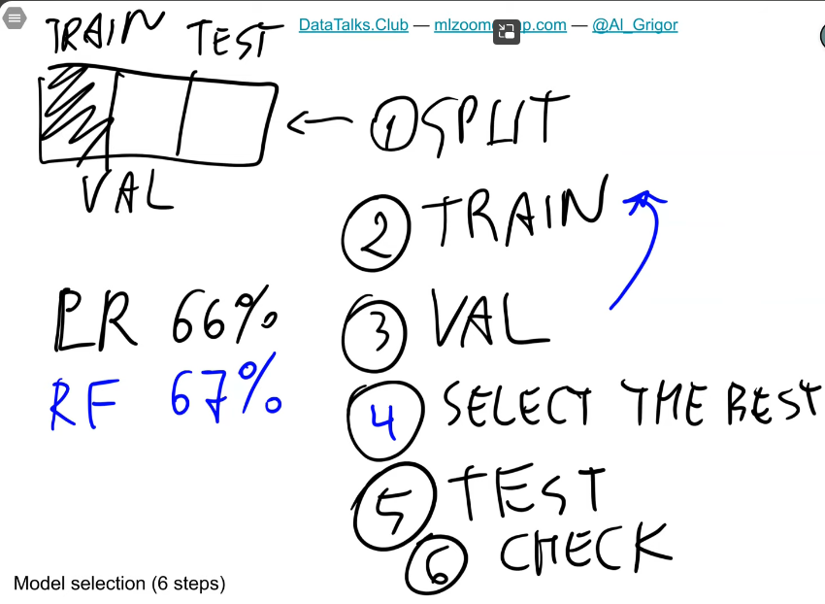

Model Selection
1. Model Evaluation process:
Divide dataset into 2 parts. Training data to train the models and test data to validate the results of the models.
In practice it might not work
A model may luckily give good result on the validation dataset.
2. Multiple Comparison Problem
When testing many models again a single validation data, one of the models may turn out lucky out of no reason.
Therefore, We divide our dataset into 3 parts instead of 2. Train data, Validate data, and finally a test data which will be used after validation to avoid the model from being lucky twice.
Dataset(100%)
Train 80% | Test 20% |  | X
Train 60% | Validate 20% | Test 20%
3. Solution
After selecting a good model, retrain with 80 % of the data by combining training data with validation data to get a good final model.
Finally use the test data on improved model to validate the results

Slide 6
Homework
Set up the environment
You need to install Python, NumPy, Pandas, Matplotlib and Seaborn. For that, you can the instructions from 06-environment.md.
Question 1
What's the version of Pandas that you installed?
You can get the version information using the __version__ field:
pd.__version__
A 1.3.4
Getting the data
For this homework, we'll use the California Housing Prices dataset. Download it from here.
You can do it with wget:
wget https://raw.githubusercontent.com/alexeygrigorev/datasets/master/housing.csv
Or just open it with your browser and click "Save as...".
Now read it with Pandas.
Question 2
How many columns are in the dataset?
10
6560
10989
20640
Question 3
Which columns in the dataset have missing values?
total_rooms
total_bedrooms
both of the above
no empty columns in the dataset
Question 4
How many unique values does the ocean_proximity column have?
3
5
7
9
Question 5
What's the average value of the median_house_value for the houses located near the bay?
49433
124805
259212
380440
Question 6
Calculate the average of total_bedrooms column in the dataset.
Use the fillna method to fill the missing values in total_bedrooms with the mean value from the previous step.
Now, calculate the average of total_bedrooms again.
Has it changed?
Has it changed?
Hint: take into account only 3 digits after the decimal point.
Yes
No
Question 7
Select all the options located on islands.
Select only columns housing_median_age, total_rooms, total_bedrooms.
Get the underlying NumPy array. Let's call it X.
Compute matrix-matrix multiplication between the transpose of X and X. To get the transpose, use X.T. Let's call the result XTX.
Compute the inverse of XTX.
Create an array y with values [950, 1300, 800, 1000, 1300].
Multiply the inverse of XTX with the transpose of X, and then multiply the result by y. Call the result w.
What's the value of the last element of w?
Note: You just implemented linear regression. We'll talk about it in the next lesson.
-1.4812
0.001
5.6992
23.1233

